Slide 1
Bank Marketing
Analysis
Survive
Economic Crisis
By : Jonathan Aditia
Datasets From :
https://archive.ics.uci.edu/ml/datasets/Bank+Marketing
https://www.kaggle.com/volodymyrgavrysh/bank-marketing-campaigns-dataset

Slide 2
Agenda Style
01
Introduction
Content And Personal Introduction
04
Timeline And Problem Sets
Portugal Banking Timeline And Problem Sets
10
Data Analysis
Full Data Analysis and Insight
39
Recommendation
Data Conclusion and Recommendation

Slide 3

Jonathan Aditia
2015
2017
2018
2019
Value Investor
2015 - present
Jo Smiley
Clothes And Bags Business
The Classic Barber
Barbershops
Aneka Minuman
Drinks shops
Jonathan Aditia
2017 - 2018
2018 - present
2019 - present

Slide 4
Portuguese Banking Timeline

Slide 5
Financial Timeline
Portugal
2008
2010
Financial Crisis
The financial crisis on Portugal reach It’s peak
Financial Crisis
Recovery Process
Following The 2007 US Mortgage Crisis,
The World Financial Crisis Affected Various Institution Around The Globe In 2008
The Crisis Hit It’s Peak When Lehman Brothers Filed For Bankruptcy
World financial crisis in recovery
Portugal GDP rising
2009

Slide 6
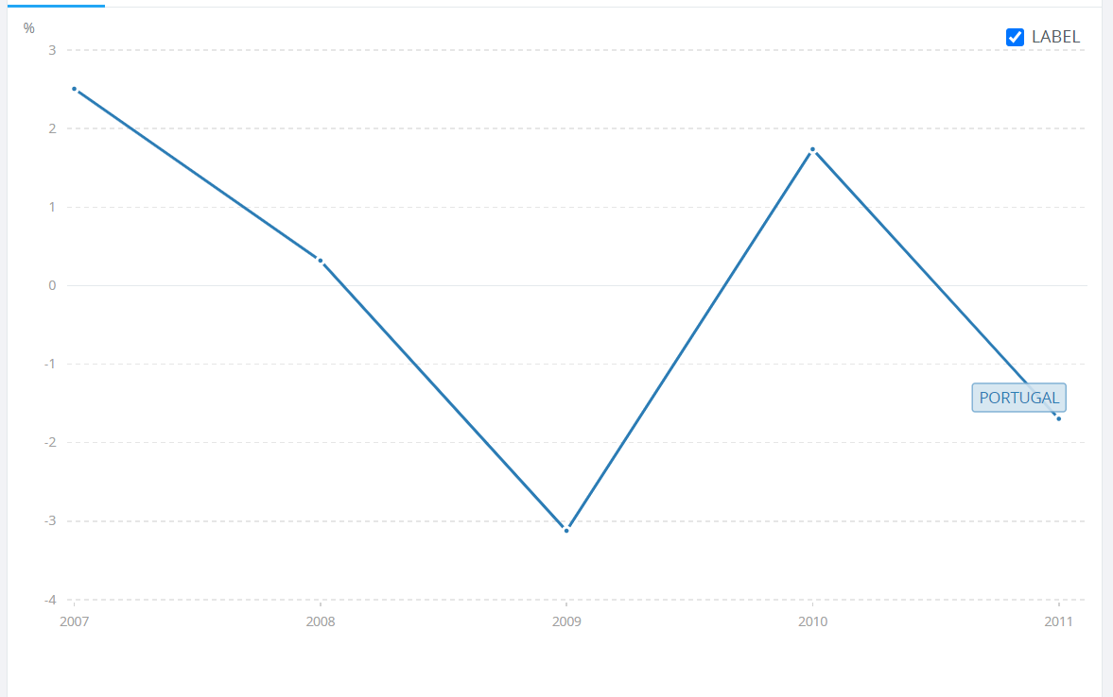
Portugal GDP Change
During 2008- 2010 Portugese
Economy Is
In Crisis
The chart on the left showing Portugal GDP change From 2007 to 2011

Slide 7
Problem Sets

Slide 8
Bank Challanges
Capital
Liquidity
Companies Including Banks Need To Spend Their Capital Wisely
Banks Often Experience Liquidity Problems, Due to Massive Numbers of Customers Cashing-Out
Non-Performing Loan
Deposits
Liquidity Problems Often Gets Severe, Since There Might Be A Spike In Non-Performing Loan Credits
Banks Need as Much Deposits as Possible From Customers, But Still Has to Maintain It’s Cost

Slide 9
Focus Problem
Customers Saving Rates Drop Significantly During Crisis, But The Marketing Cost Are Still High
Marketing
Problems
Bank Has To Cut Marketing Expenses

Slide 10
Data Analysis

Slide 11
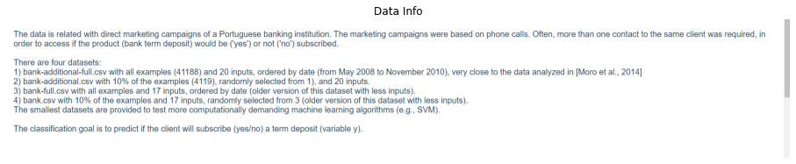

Data Information
This Data Was Taken From May 2008 To November 2010
The Data Was Taken During World Financial Crisis

Slide 12
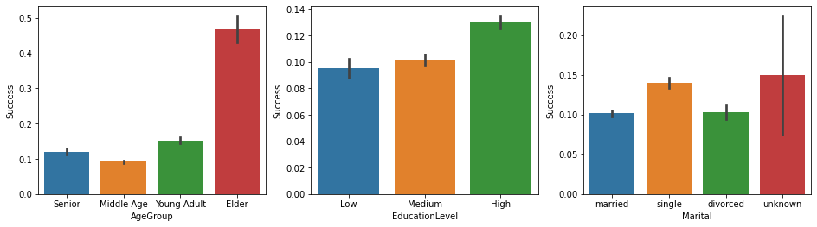
Analysis On Customers
Elders Are The Most Likely to Put A Term Deposits, This Due to A Much Higher Savings Rate Among Elders Compare to Other Age Groups
People With Higher Education, Slightly More Likely to Put A Term Deposits, But The Differences Is Still Small Compared to Other Eurozone Countries
Single Customers Are The Most Likely To Put A Term Deposits, This Due To Higher Saving Rate Of Single Compare To Married And Divorced Customers

Slide 13
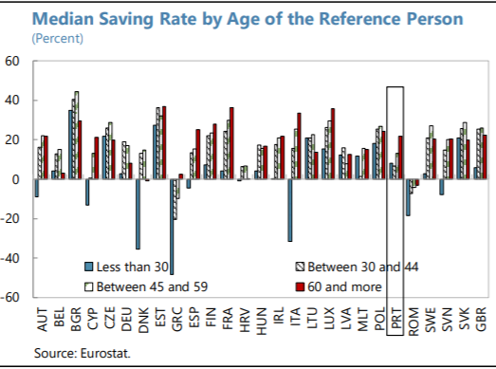
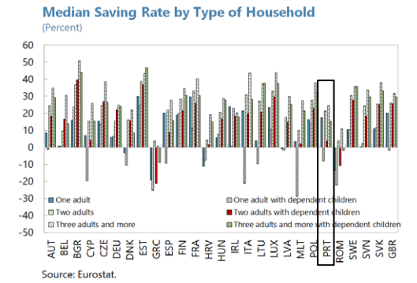
Analysis On Customers
Median Saving Rates Are Highest For People Age 60 And More
Median Saving Rates Are Highest Among Single People

Slide 14
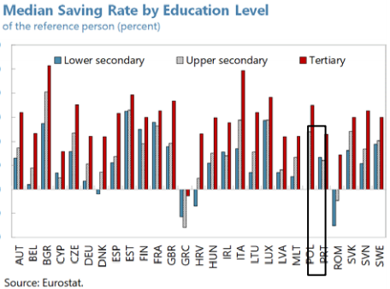
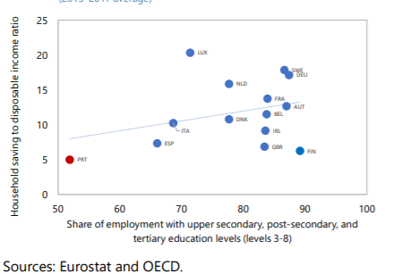
Analysis On Customers
Customers With Higher Education Has Higher Saving Rates
But Saving Rates Among Portuguese Are Lower Than Eurozone Average

Slide 15
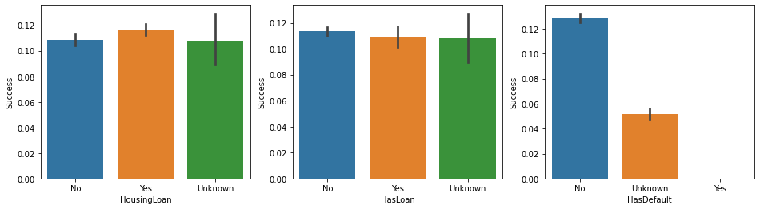
Analysis On Customer Loan
There Is No Significant Differences on Successful Campaign Rate Between Customers With Loans And Customers With No Loans

Slide 16
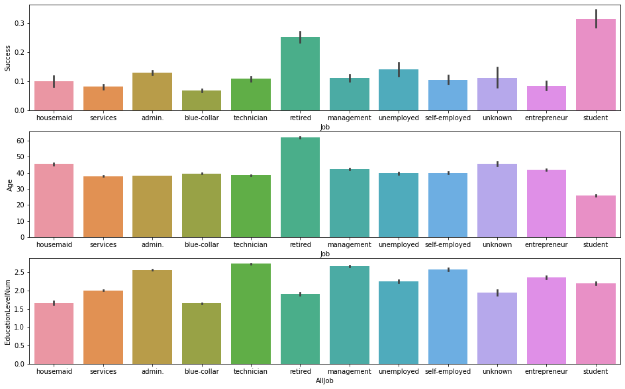
Analysis On Customer Job
Each Job Group Has Different Rate of Successful Campaign

Slide 17
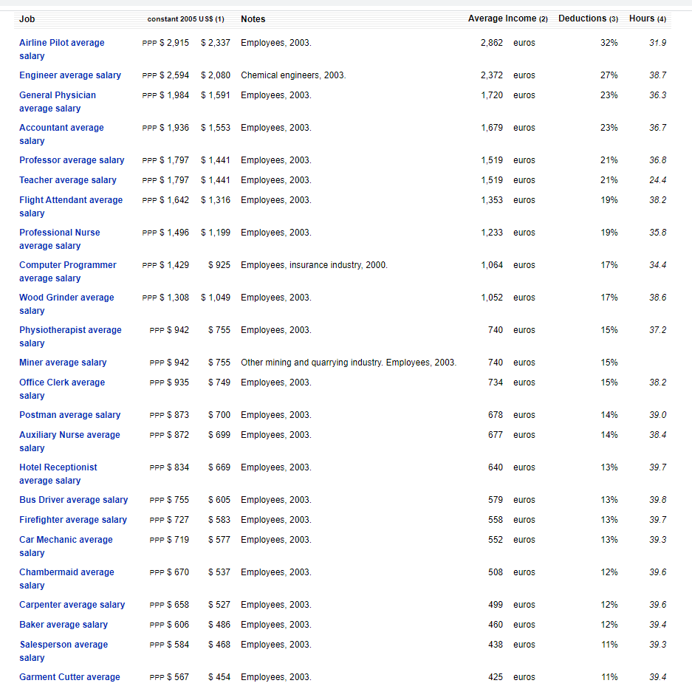
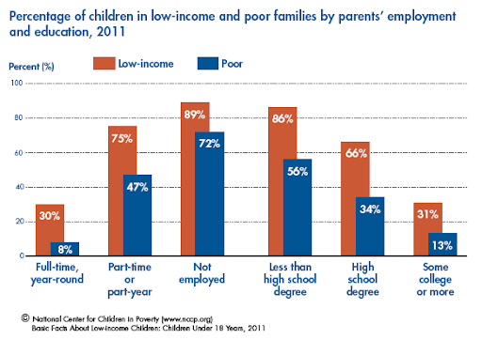
Analysis On Customers Job
Customers With High Income Job Are More Likely To Put A Term Deposits
College Students Has Higher Chance To Put A Term Deposits
This Because They’re More Likely To Come From Higher Income Family

Slide 18
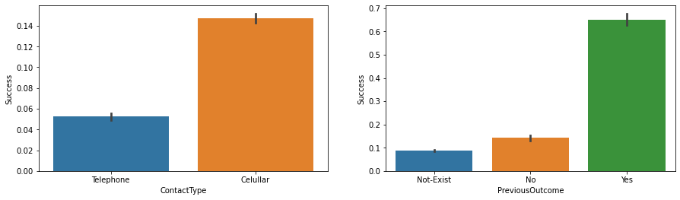
Analysis On Customer Contact
On Average, Cellular Are More Effective For Marketing Compared With Telephone
Customers With Deals on Previous Campaigns, Are More Potential To Put A Term Deposits
Customers Put A Term Deposits on Previous Campaigns Are Proven To Have A Records on Putting Term Deposits

Slide 19
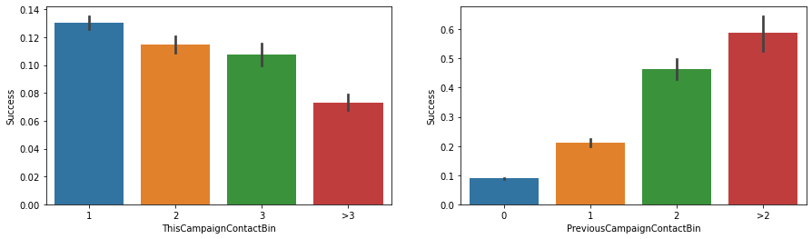
Analysis On Customer Campaign
Previously Contacted Customers Has A Far Higher of Successful Campaign Rate
As Shown Below, The Customers That Put Term Deposits on Previous Campaign, Have More Average Previous Contact History
This Is Some of Recurring Customers But There Might Be Some Other Factors Such As Familiarity And Trust
Previous Contact Existence Are Signs, The Person Has Already Been A Loyal Customer At Least Since The Previous Campaign
The Highest Success Rate Is at The First Contact of The Campaign, The Rest Has A Relatively Lower Success Rate
This Indicate That Some Customers Wouldn't Change Their First Response

Slide 20
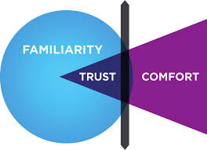
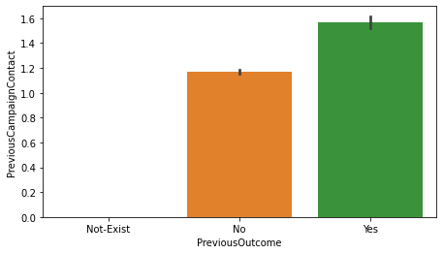
Analysis On Customers Campaign
Previously Contacted Customers Tend To Be Older Than Customers That Has No Prior Contact
This Increases The Rate of Successful Campaign on Previously Contacted Customers, as Older People Has Higher Saving Rate
On Previous Campaign, Students Are Contacted The Most
This Also Increases The Rate of Successful Campaign on Previously Contacted Customers, as on Previous Campaign, Students Has A High Probability on Putting Term Deposits
There Might Also Be Some Psychological Factors, Such As Familiarity And Trust
Having Records on Being Contacted Before Is A Sign, That This Customers Has Been Staying For At Least Since The Last Campaign

Slide 21
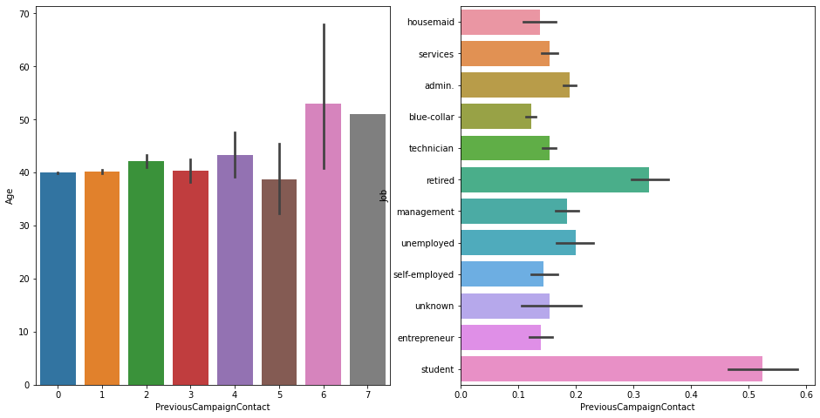
Analysis On Customers Campaign

Slide 22
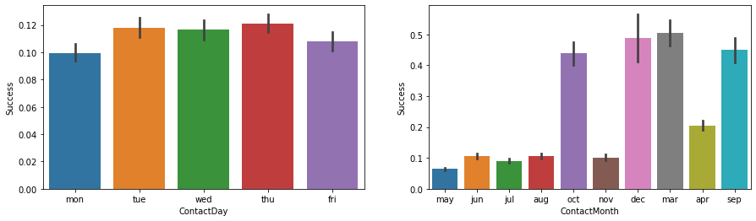
Analysis On Contact Days And Months
March, September ,October And December Are The Months With Highest Rate of Successful Campaign
But Despite The Higher Rate Of Successful Campaign, The Total Number Of Successful Campaigns Still Less Than Average
May, June, July, August, And November Are The Months With Lowest Rate of Successful Campaign
This Due To Lower Rate Of Savings During Summer, And Too Much Uneffective Contact Performed
But Despite The Lower Rate Of Successful Campaign, The Total Number Of Successful Campaigns Are More Than Average
Monday And Friday Has The Least Successful Campaign Rate
This Might Be Linked To A Psychological "Mid-Week of Weekdays" Factor, But Still Unclear And Need A Further ResearchJournal Referrence :
https://journals.plos.org/plosone/article?id=10.1371/journal.pone.0134555

Slide 23
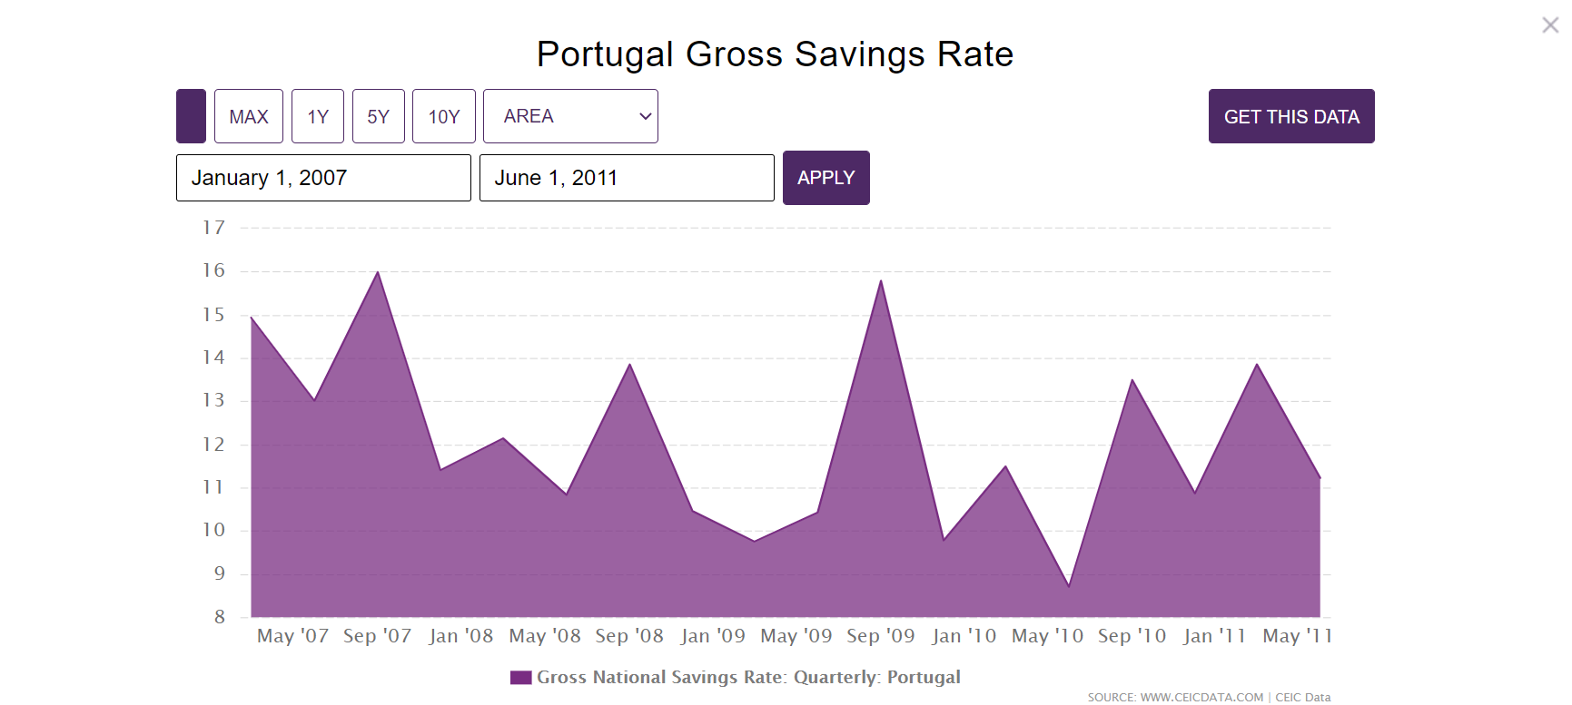
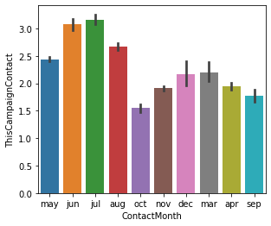
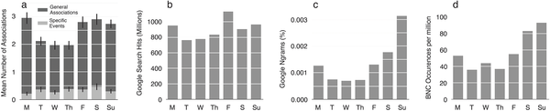
Analysis On Customers Job
Portugal Saving Rate
Average Number of Contact per Customer By Month
Research on Performance By Day of Weeks

Slide 24
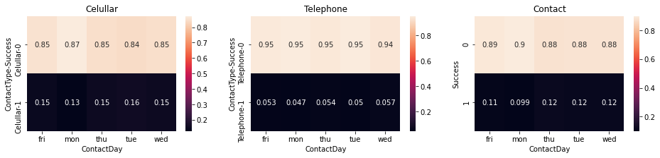
Analysis On Customers Contact Type And Days
Monday And Friday Are The Least Successful Day To Perform The Campaign by Both Telephone And Celullar

Slide 25
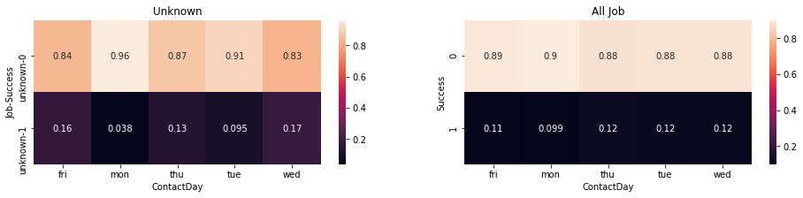
Analysis On Customers Job And Days
Each Job Groups Had Different Best Day To Perform The Contact
On Average, Mid-Week of Weekdays Are The Best Time To Perform The Contact

Slide 26
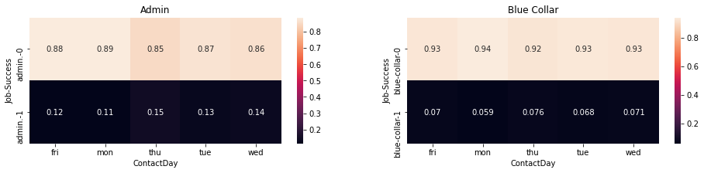
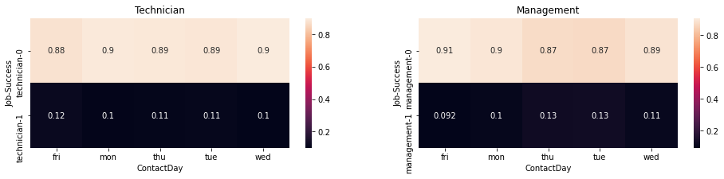
Analysis On Customers Job And Days

Slide 27
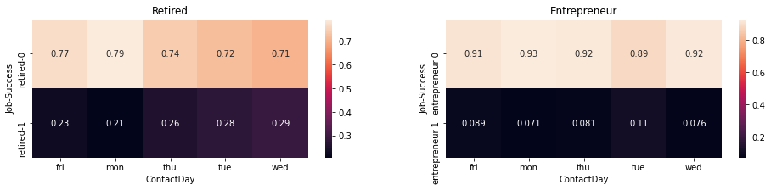
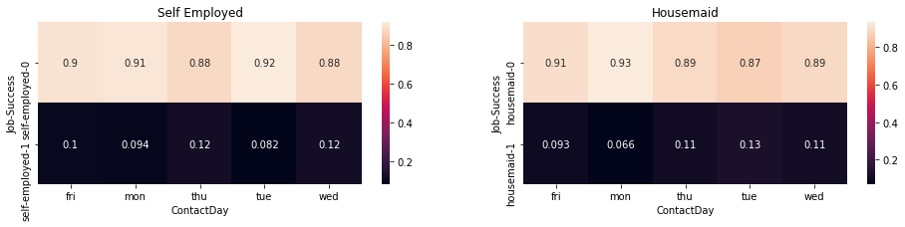
Analysis On Customers Job And Days

Slide 28
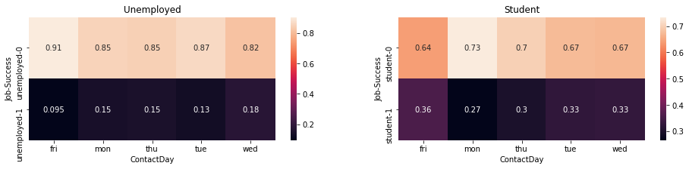
Analysis On Customers Job And Days

Slide 29
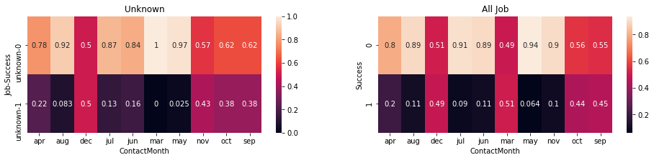
Analysis On Customers Job And Months
Each Job Groups Had Different Best Month To Perform The Contact
On Average, March, September, October, And December Are The Best Time To Perform The Contact

Slide 30
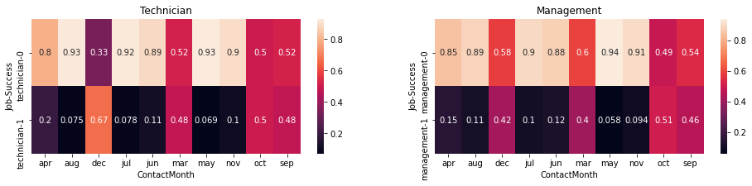
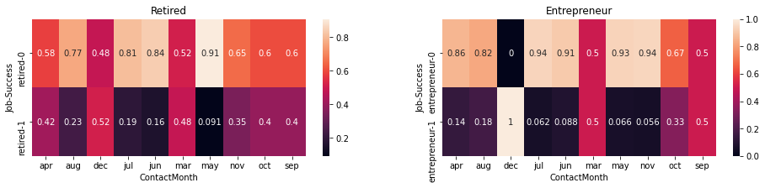
Analysis On Customers Job And Months

Slide 31
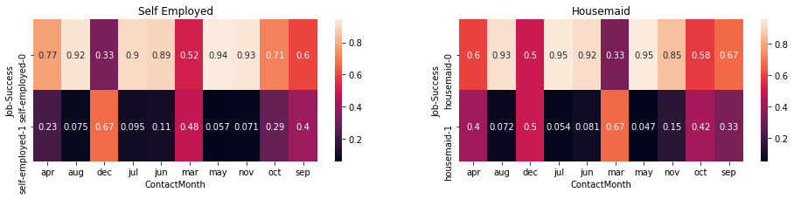
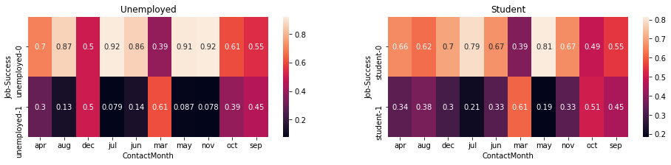
Analysis On Customers Job And Months

Slide 32
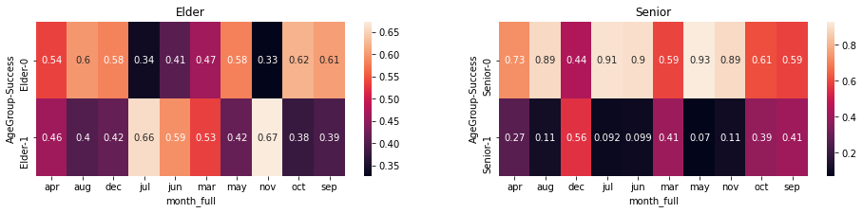
Analysis On Customers Age Group And Months
November, July, And June Are The Best Month To Perform The Contact For Elders

Slide 33
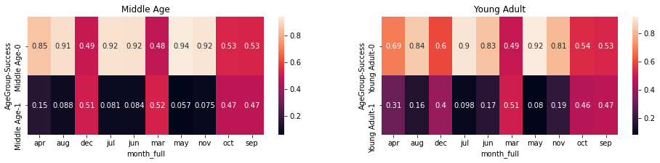
Analysis On Customers Age Group And Months
March, September, October, And December Are The Best Month To Perform The Contact On Senior, Middle Age, And Young Adult

Slide 34
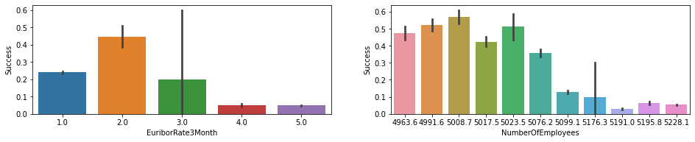
Analysis On Economic Factor

Slide 35
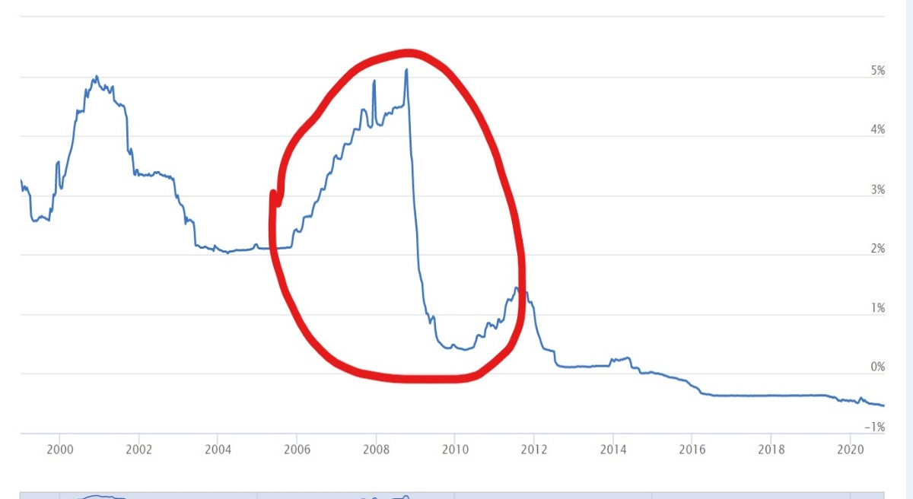
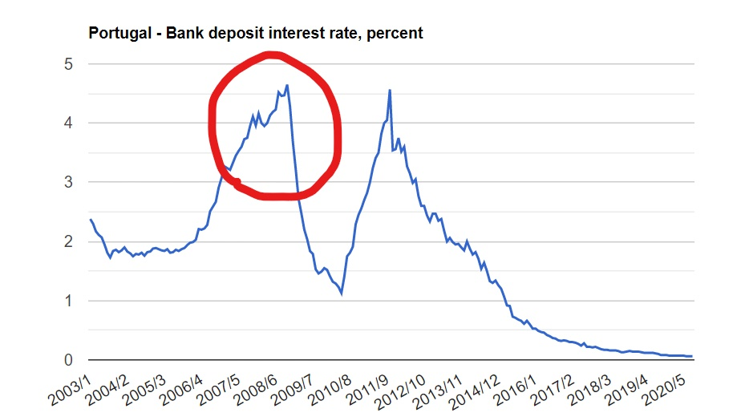
Analysis On Economic Factor
Portugal Deposit
Interest
Rate
Euribor Rate

Slide 36
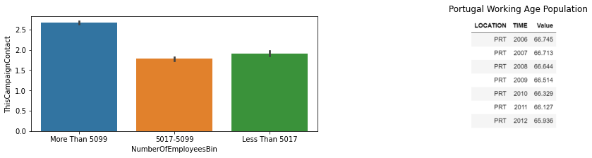
Analysis On Economic Factor

Slide 37
Analysis On Economic Factor
The Successful Campaign Rate Is Lower During Higher Euribor Rate
Euribor Is The Average Rates of Interbank Borrowing Rates Based on Supply And Demand
The Raise And Lower Interest Rate For Bank Customers, Mirrors Euribor Rates
High Euribor Rates Is A Sign on Low Saving Rates
When Borrowings Are High And Saving Rates Are Low, Euribor And Bank Rates Is Raised to Make Borrowings More Expensive
Lower Saving Rates Causes Euribor To Raise, Vice Versa
Successful Campaign Rate Are Lower During Higher Number Of Employee
This Is Because Too Many Calls Performed on The Same Customers
As Shown Before, 2nd Call And More Has Lower Rate Of Successful Campaign
The Number of Employee Are Volatile During 2008-2010, This Is Due To Extreme Economic Factors, Not Working Population Changes

Slide 38
Recommendation

Slide 39
Recommendation
Marketing Expenses Can Be Lowered By Making It More Efficient, Especially on Customers With Low Potential
There Are Ways To Make Campaign on May, June, July And August More Efficient, Since There's A Lot of Repeat Contact on The Same Customer Between This Months
Marketing Should Be More Focused on Elders, Since Successful Campaign Rate And Saving Rate Are Higher Among Elders
Marketing Should Be More Focused To Students And Retired Customers, Since Successful Campaign Rate Are Higher Among This Group
Marketing Via Cellular Are More Efficient, But Still Considering About Customers Age, Job, Time And Number of Contact on The Same Campaign
Term Deposit Marketing, Should Be Used For Liquidity Purpose, And Not Making Loans Aggressively, Since The Non-Performing Loan Ratio Is Rising During Crisis
During Crisis, Management Should Be More Careful on Approving Customer Loan Proposal, This Is To Keep Non-Performing Loans Under Control
It's Far Better To Have Temporary Excess Liquidity, Rather Than Approving Risky Loans
As Warren Buffett Believes, Good Managers Are Always Looking For Ways To Cut Costs, And Very Rarely Make Risky Loans
Reference:
Warren Buffett Portofolio "Mastering The Power of Focus Investment

Slide 40
References

Slide 41
References
References on Portugal Banking and Economic Landscape 2008-2010 :
Banco Português de Investimento Annual Report 2007-2010
Millenium Banco Comercial Português Annual Report 2009-2010
Millenium Banco Comercial Português Sustainability Report 2009-2010
www.ceicdata.com
www.worldbank.org
www.oecd.org
www.ec.europa.eu
www.journals.plos.org

Slide 42



Tribute To
Team of Purwadhika Coding School :
Mr. Khumaeni
Mr. Muhammad Nurrokim
Mr. Alfazrin Banapon
Purwadhika Admin
Fellow Friends From JCDS 10

Slide 43
Thank you

